Slide 1
30 July 2026

Slide 2
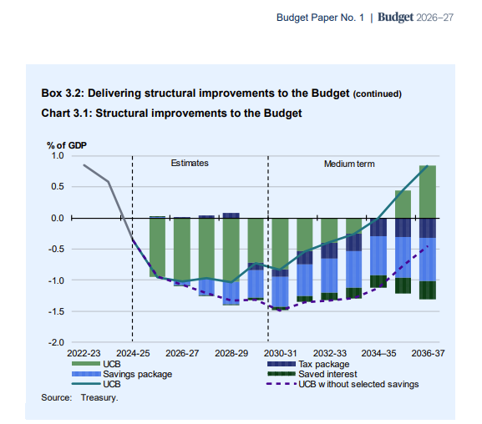
Key policy directions of Federal Budget 2026
Budget 2026 took place given rising concerns about fiscal sustainability, intergenerational equity, and productivity growth – three topics that are closely linked.
NDIS reforms.
  Details are currently limited – but these savings were the main drivers of surplus returning.
  Thriving kids program a significant part, however a lot of community and social support likely to be removed.
Tax reforms.
  WATO and the future taxation of labour income.
  Liquidity and R&D policies for small and young firms.
  Minimum trust tax rate.
  Capital gains and negative gearing.

Slide 3
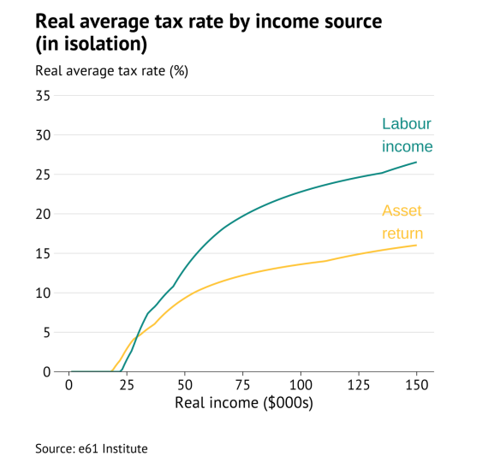
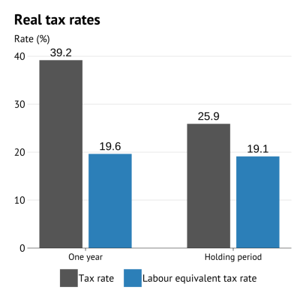
Taxation of income
Understanding taxation of capital gains requires thinking about income tax.
Tax capital like wages? Intergenerational equity? Equity-efficiency trade-off.
What is income?
Tax changes in the capacity to consume irrespective of how we do so (https://e61.in/e61-capital-income-tax-calculator/).
Fixer-upper sale
High inflation property investor

Slide 4
Taxation of income
Understanding taxation of capital gains requires thinking about income tax.
Tax capital like wages? Intergenerational equity? Equity-efficiency trade-off.
What is income?
Tax changes in the capacity to consume irrespective of how we do so.
Capital income as a return to savings.
Inflation reduces the value of nominal savings – not income.
A normal rate of return compensates for deferring consumption – necessary to maintain present value of savings, so not income.
To tax all true income the same way we can either tax consumption, or tax labour income + capital income above a normal rate of return.
Hard to create the redistribution we may want with consumption taxes (progressivity). Hence an income tax is needed.

Slide 5
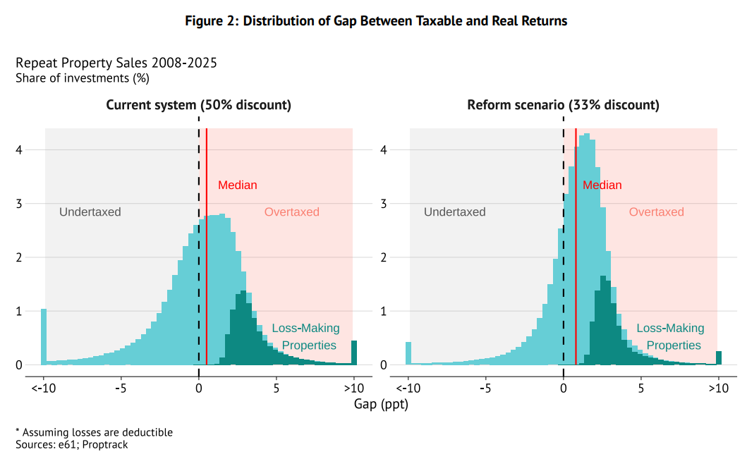
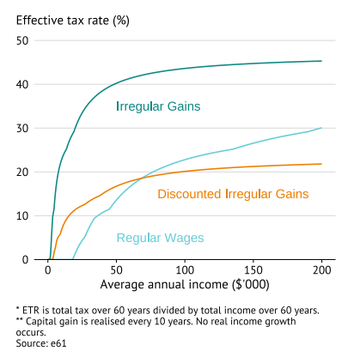
What are capital gains and negative gearing
A capital gain is an additional form of capital income.
Like other capital income, some of it is not “income”.
Is taxed on realisation – this gives capital gain a deferral benefit relative to other capital income currently.
Due to progressive taxes, capital gains are taxed at a higher rate than if they were taxed each year.
Discount and income averaging

Slide 6
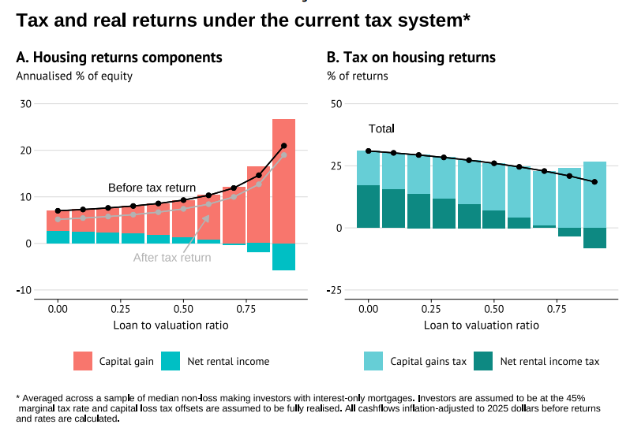
What are capital gains and negative gearing
Negative gearing is when annual revenue for an asset in a year is less than the costs, due to borrowing expenses.
Only allow expenses related to taxed income. Allowing deductibility of inflation component of interest inconsistent with discount/indexation.

Slide 7
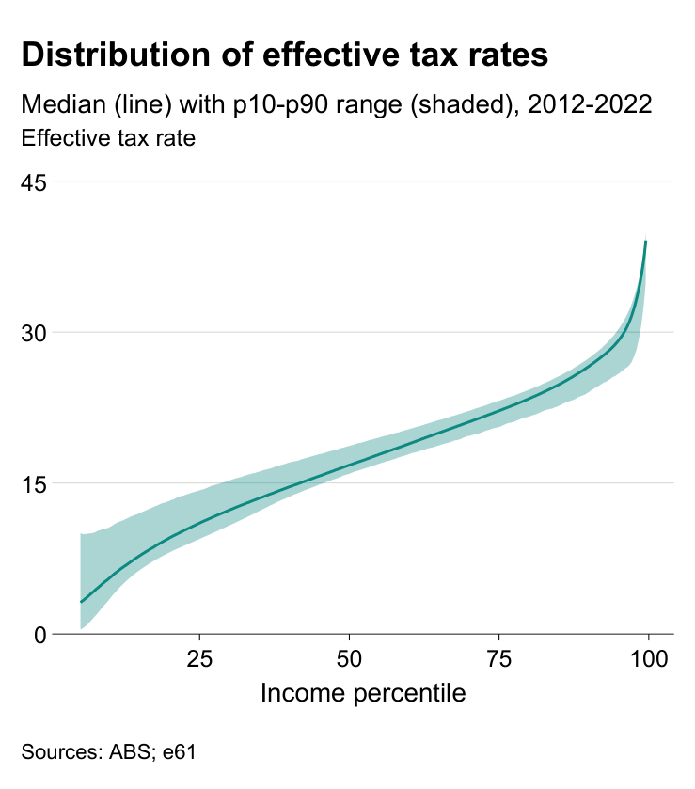
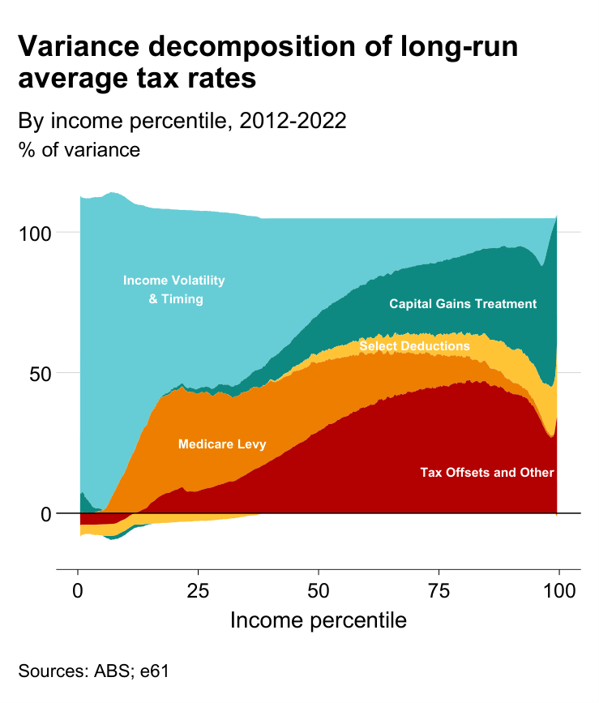
Issues with prior treatment
Horizontal inequity

Slide 8
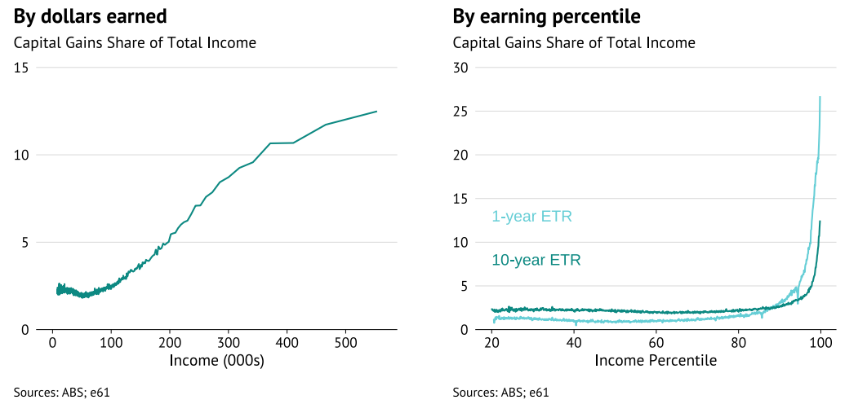
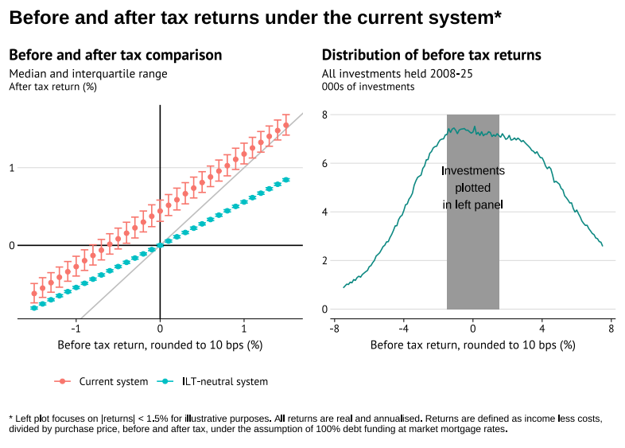
Issues with prior treatment
Vertical inequity
Capital gains tend to go to this with high
decade-long income.
Implies that the tax-system may be less
progressive than intended.
Incentive to borrow too much
Increasing leverage allows an investor to
increase their return on equity (RoE) post-tax
by more than the pre-tax increase.
-> Can turn a pre-tax negative return
positive post-tax

Slide 9
Implications for revenue
It was not clear these reforms should increase revenue.
Asymmetric treatment of losses.
No “income averaging” – over-taxation of lumpy income such as capital gains, incentives for strategic timing.
Minimum rates.
Is inflation the correct discount rate?
Consistency would also discount other capital income.

Slide 10
Trade-offs
Capital mobility and investment
Compliance costs

